Slide 1

Fruit Belt Eastside
Community Development Project
Rev. Dr. Michael Chapman
Founder & CEO
Notes:
FRUIT BELT/EAST SIDE COMMUNITY DEVELOPMENT PROJECT

Slide 2
Education and Grantsmanship
2003-Present
Christ the King Seminary, East Aurora, New York
Degree Candidate Masters in Systematic Theology
1998-2003
Christ the King Seminary, East Aurora, New York
Master of Divinity
2001-2007
Christ the King Seminary, East Aurora, New York
Master of Arts Pastoral Ministry
Rev. Dr. Bennett W. Smith, Sr., Family Life Center:
Dormitory Authority of the State of New York and the New York State office of Child and Family Services. Capital Grant for $1,000,000.
U.S. Department of Health and Human Services, Health Initiative for $906,000.
City of Buffalo Community Development Block Grant for $300,000.
Erie County Neighbor Helping Neighbor Grant for $150.000-200.000
Erie County Department of Youth Services, Programmatic Grant for $50,000.
Health Initiative: New York State Department of Health for $75,000. Breast and Cervical Cancer Grant
St. John Baptist/Hospice Buffalo House: $2,800,000.
City of Buffalo Community Block Grant for $100,000 under the Masieillo Administration and $300,000 under the Brown Administration
Federal Allocation from State Congresswoman Louise Slaughter for $300,000
Allocation from Assembly Member Crystal Peoples for $100,000
Allocation from Erie County Executive Joel Giambra for $100,000
Allocation from NYS Governor George Pataki through the Empire State Development Corporation for $600,000
Allocation from the John R. Oshei Foundation for $400,000
Allocation from the Margaret L. Wendt Foundation for $400,000
Hospice and Palliative Care for $107,000
St John Fruit Community Development Corp. $460.000
Notes:
Rev. Dr. Bennett W. Smith, Sr., Family Life Center:
Dormitory Authority of the State of New York and the New York State office of Child and Family Services. Capital grant for $1,000,000.
U.S. Department of Health and Human Services, Health Initiative for $906,000.
City of Buffalo Community Development Block Grant for $300,000.
Erie County Neighbor Helping Neighbor Grant for $150.000-200.000
Erie County Department of Youth Services, Programmatic Grant for $50,000.
Health Initiative Linkage Agreements, Twenty-three agreements secured. New York State Department of Health for $75,000. Breast and Cervical Cancer Grant
St. John Baptist/Hospice Buffalo House:
City of Buffalo Community Block Grant for $100,000 under the Masieillo Administration and 3000 under the Brown Administration
Federal Allocation from State Congresswoman Louise Slaughter for $300,000
Allocation from Assembly Member crystal Peoples for $100,000
Allocation from Erie County Executive Joel Giambra for $100,000
Allocation from NYS Governor George Pataki through the Empire State Development Corporation for $600,000
Allocation from the John R. Oshei Foundation for $400,000
Allocation from the Margaret L. Wendt Foundation for $400,000
Hospice and Palliative Care for $107,000
St John Fruit Community Development Corp. $460.000

Slide 3
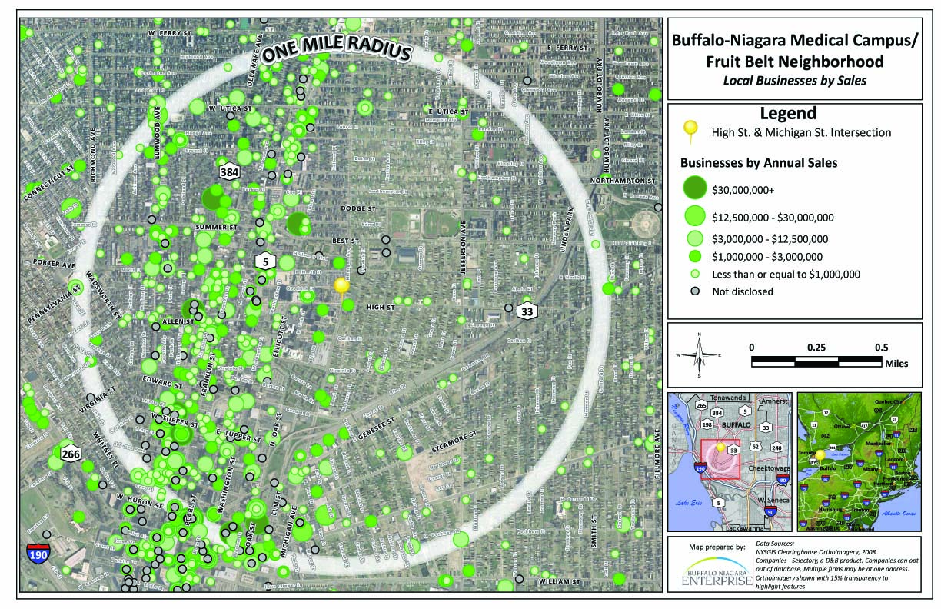

Slide 4
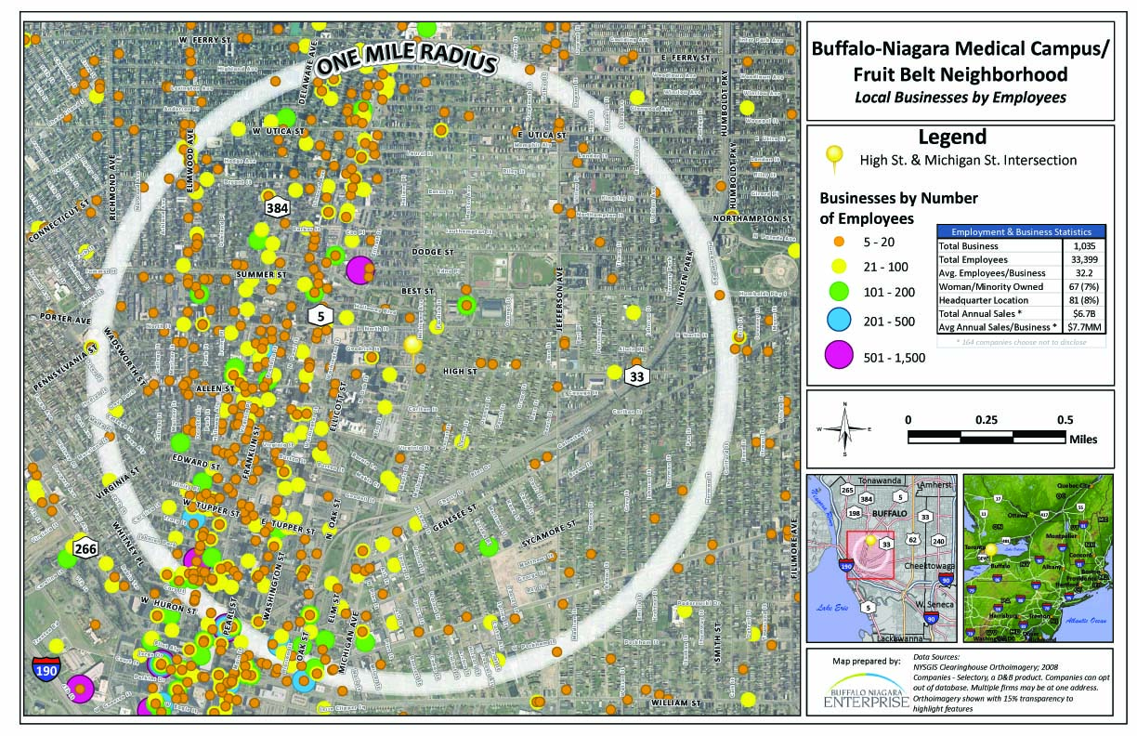

Slide 5
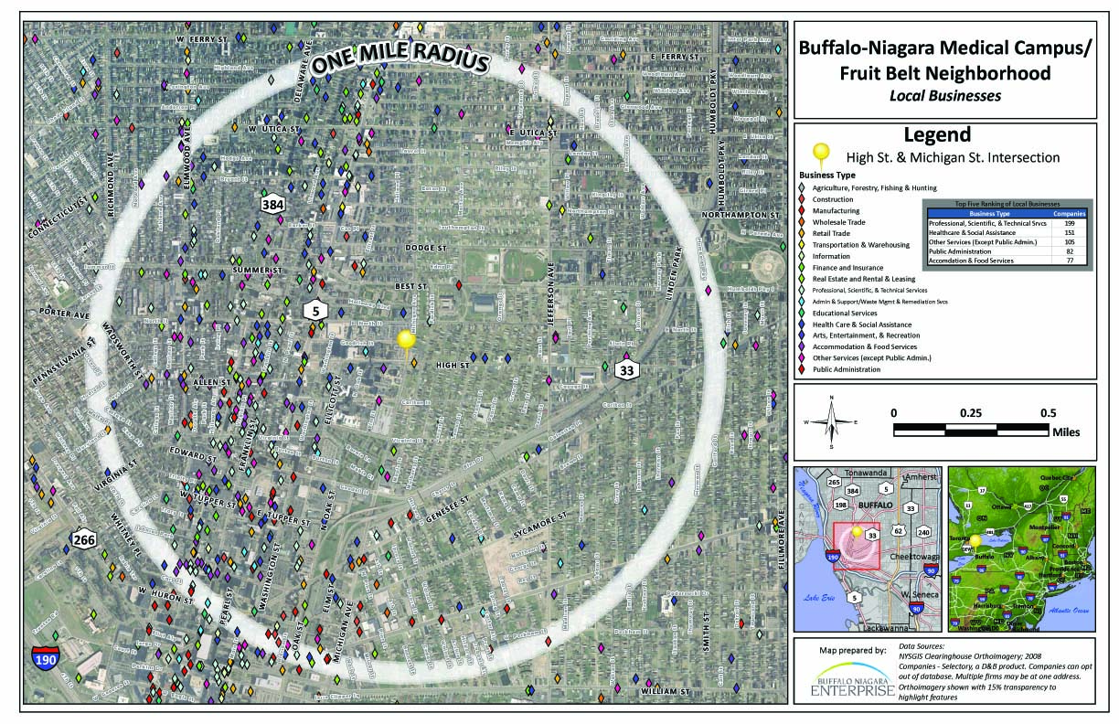

Slide 6
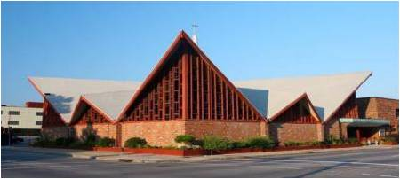
St. John Baptist Church
90 Years
Founded in 1927
Proven record of service to the Community and Congregation
3500 Member Congregation
St. John Campus – 45 acre site located in downtown Buffalo
Currently over $60 Million in facilities
McCarley Gardens – 150 Unit Housing Complex
St. John Tower – 150 Unit Senior Citizens Complex
Notes:
Founded in 1927
Proven record of service to the Community and Congregation
3500 Member Congregation
St. John Campus – 45 acre site located in downtown Buffalo
Currently over $45 Million in facilities
McCarley Gardens – 150 Unit Housing Complex
St. John Tower – 150 Unit Senior Citizens Complex

Slide 7
St. John Baptist Church
90 Years
Churches, Campus and Village Complex
St. John Federal Credit Union
St. John Hospice/Developed in cooperation with Hospice Palliative Care Corporation of Cheektowaga, NY
7 Single Family Homes Owner Occupied
Aloma D. Johnson Fruit-Belt Community Charter School
St. John Christian Academy
The Rev. Dr. Bennett W. Smith, Sr. Family Life Center
28 Multi Family Rental Residences
Gethsemane Missionary Baptist Church
Gethsemane Reality Corporation
Gethsemane Foundation
Notes:
St. John Federal Credit Union
St. John Hospice/Developed in cooperation with Hospice Palliative care Corporation of Cheektowaga, NY
7 Single Family Homes Owner Occupied
Aloma D. Johnson Fruit-Belt Community Charter School
St. John Christian Academy
The Rev. Dr. Bennett W. Smith, Sr. Family Life Center
28 Multi Family Rental Residences

Slide 8
St. John Organizational Chart

Slide 9
St. John Baptist Church
90 Years
SJBC Organizational Chart
Represents a Staff of 2400 which consists of:
Employees
Independent Contractors
Consultants
Volunteers
Loaned Executives

Slide 10
COLLABORATIVE PARTNERS
ST. JOHN FRUIT BELT COMMUNITY DEVELOPMENT CORPORATION
FRUIT BELT & EASTSIDE DEVELOPMENT TEAM
The following is a listing of individuals and organizations who have committed to memorandums of understanding in a collaborative effort as partners for the development of the Fruit Belt and Eastside of Buffalo, New York.

Slide 11
St John Fruit Belt CDC
High Street Commercial Development Project
Memorandums Of Understanding (MOU’s)
ADM Management Group, Inc.
Alesia’s Cleaning/Construction Services, MBE
Appaloosa Productions Ltd.
ARC & COMM (American Rated Cable & Communications)
Back to Basics Outreach Ministries, Inc
Barclay Consulting
Beast Elite Academy Sports Development
Belmont Management Co., Inc.
Beulah Staffing & Training “Say Yes To Work”
Black Chamber of Commerce of WNY
Blessed of the Lord Ministries
Bright Options Family Services, Inc.
Buffalo & Erie County Workforce Development Consortium, Inc.
Bureau of Jewish Education of Greater Buffalo
Bynum Brothers
Calhoun Insurance Agency, Inc
Center for Hospice & Palliative Care
CGP Properties LLC d/b/a Saybrook Enterprises
Chapman’s Outsource Management
Conscious Investment Group (CIG)
C & R Housing Inc. City of Buffalo – Board of Education

Slide 12
St John Fruit Belt CDC
High Street Commercial Development Project
Memorandums Of Understanding (MOU’s)
Community Action Organization of Erie County, Inc. (CAO)
Created for Success
Davis Cleaning and Supply Co.
DGM Management
D.I.V.A.S. For Christ, Inc.
Dr. Daniels & Associates
East Side Redevelopment Task Force, Inc.
Empire State Development Corporation
Erie County Industrial Development Agency (ECIDA Family Real Estate Development Services
F.A.T.H.E.R.S.
First World Publishing
Fruitbelt Beverage Store
Fruit Belt United, Inc.
God’s Farmacy
Going Up Construction, Inc.
Grace MB Outreach Corporation
Green Hornet Moving, Hauling & Landscaping
H & L Home Improvement
Hairston Hosiery

Slide 13
St John Fruit Belt CDC
High Street Commercial Development Project Memorandums Of Understanding (MOU’s)
Ha’naniah Lutheran Church
H.E.A.R.T. Foundation (Helping Empower At Risk Teens)
Heavenly Hands Commercial Cleaning, LLC
Hope for Humanity CDC & Tabernacle of Praise Inc
LUCID Pathways
MAD DADS of Greater Buffalo
Maple, Mulberry & Locust (MML) Fruit belt Coalition
MEGA Consulting Services, LLC
Miracle Ministries of Buffalo NY
Modern Custodial Services
Mount Aaron Baptist Church
Nasoff-Finton, Jo K. AICP
National Black Diabetes Association
NCC Construction, Inc.
Network Knights, Inc.
100 Mighty Men Ministries
Onyx Administrative Services of BNY

Slide 14
St John Fruit Belt CDC
High Street Commercial Development Project
Memorandums Of Understanding (MOU’s)
Outsource Center for Human Services, Inc.
Project L.E.E., Inc. (Fair Chance Prison Ministries)
Project L.E.E., Inc. (S.O.W. Program)
Rayford Enterprises Inc.
Resetarits Construction Corporation
RIDALL Farm
Sheehan Health Network
Stop the Violence Coalition, Inc.
Theatre, Acting, Production Workshop Program
T.O.P. Enterprises Inc.
Turner Construction Company
Uncrowned Queens Institute for Research and Education on Women, Inc.
United Memorial & Moss Funeral Home (Consumer Casket Source)
Walking On Water, Inc.
Watts Architecture & Engineering, P.C.
WeALL Media
Western New York Information Network Association (WNYINA)
Western New York Law Enforcement Association
Western New York Minority Media Professionals Inc.
Western New York Prisoner Re-Entry Coalition, Inc
Y2J Urban Youth Ministries

Slide 15
BUSINESSES AND ENTREPRENEURS TO PROJECT DESIGN
Amherst Chamber of Commerce
Colleen DiPirro, Executive Director
Black Chamber Of Commerce
Luman Ross, Executive Director
Buffalo Economic Renaissance Corp. (BERC)
Dennis Penman, Executive Director
University of Buffalo – School of Management & Center for Entrepreneurship
Director Of Health Initiatives
Minister Ina R. Chapman
FISCAL MANAGEMENT OVERSITE
Byron Brewer, CPA
Toski & Associates
Ronald A. Toski, CPA
Managing Director
ARCHITECTURE
Foit-Albert Associates
Bonnie Foit-Albert, President/Owner
Donald Skowron, Sr. Vice President
Hannah Murano Associates, Inc.
Beverly Hannah Jones, AIA, CEO
Architect Anne Perry
Tommaso Briatico Architects
Carmina.Woods. Morris
LEGAL COUNSEL
Hodgson & Russ Attorneys at Law
LeRoi L. Johnson, Esq.
Daria L. Pratcher, Esq.
Jacqueline Stover-Stitts, Esq.
Booker Washington, Esq.
WORK FLOW NETWORKS, INC.
Roxanne Skeels

Slide 16
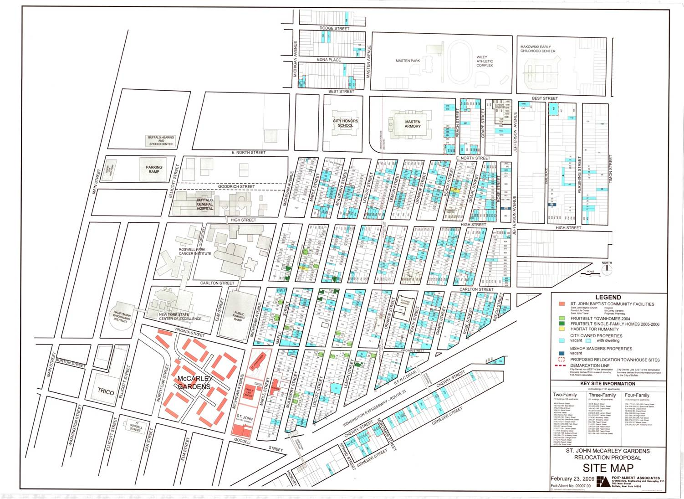
GOALS
Redevelop 42 block community adjacent to the Buffalo Niagara Medical Campus know as the Fruit Belt
  St. John Baptist Church has extensive real estate holdings which represents $60 million in development costs
  Completion of this project will add approximately
  $250 million in real estate acquisition and project development
  The results are $300 million dollars in development investments in the Fruit Belt & East Side of Buffalo.

Slide 17
Future Projects
A significant project requires a significant effort. The church and its mission driven corporations working together can make this neighborhood transformation a reality.
Senior Complexes (2 units) Low Rise 35 Units
  (Development cost, architectural service, surveys, geo tech & profile)
150 Multi Family Rental Residences
Pre-Development
Infrastructure
Environmental Review
Site Remediation
Boxing/Recreational Center Masten Park Development

Slide 18
St John Village Corporations
SJB Business Corporation
St. John Fruit Belt Community Development Corporation
Virginia-Michigan Housing Development Corporation
Oak-Michigan Housing Development Corporation
Blessed of the Lord Ministries
St. John Christian Academy*
Aloma D. Johnson FBCCS*
Rev. Dr. Bennett W. Smith Sr. Family Life Center
St. John Real Estate Corporation
MC Creative Thinkers

Slide 19
St John Village Corporations
Town Homes II
Town Homes
WECGOD, LLC(We Educate Communities Globally On Disparities)
Medical Facility
Century Life Style Health & Wellness
SJ Limousine Service
Gethsemane Foundation
Gethsemane Reality Corporation
Erma D. Robinson Day Care
Hospices

Slide 20
Community Benefits
$60 Million Investment
Projected Employment Opportunities 7,000 Over 10 Years
15 Million Investment Pre-Development Cost & Projects over last 8 years
Economic Development
Commercial Development
Housing Development
Educati0n
Health Care Services
Green Energy
Athletic Services
Improved Infrastructure
Impact the quality of life and affect change in the community

Slide 21
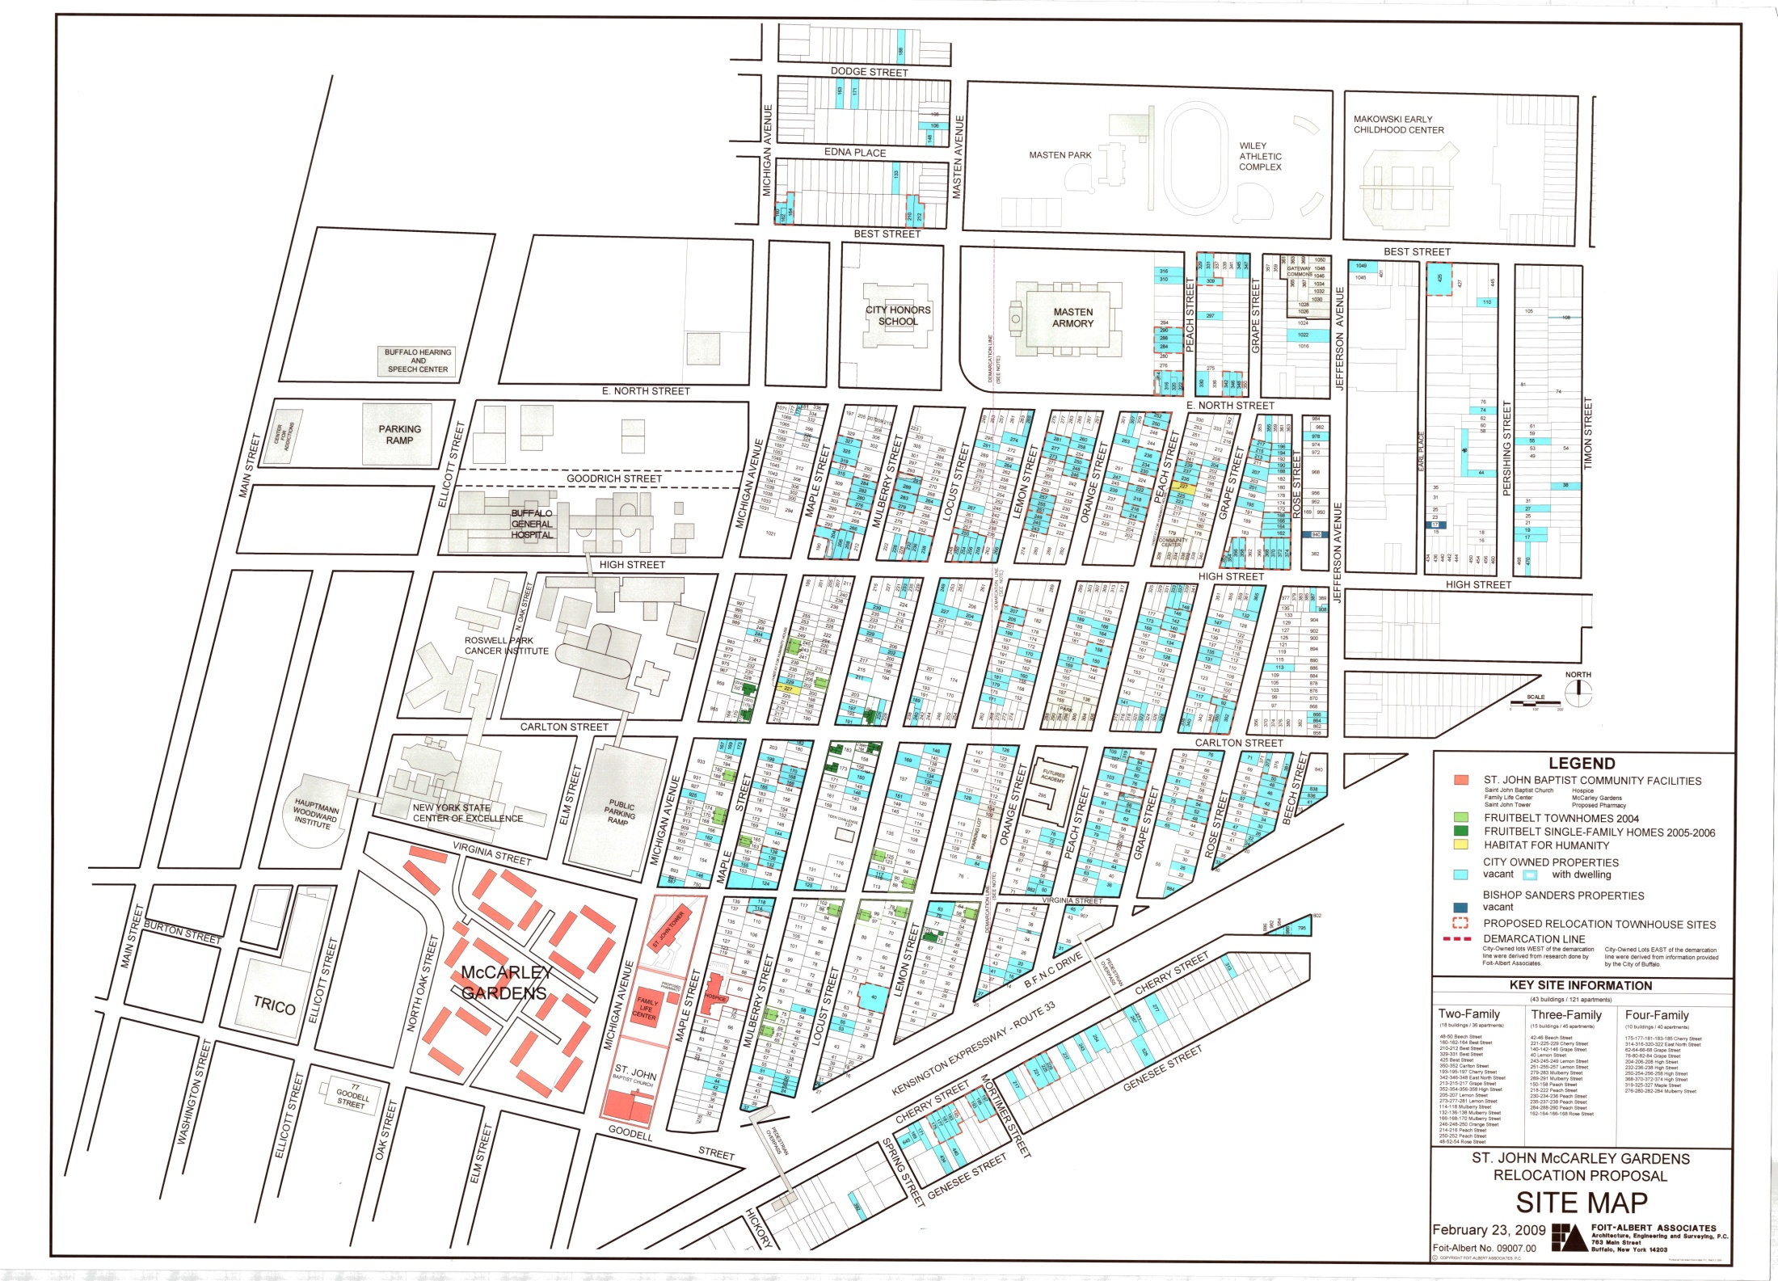

Slide 22
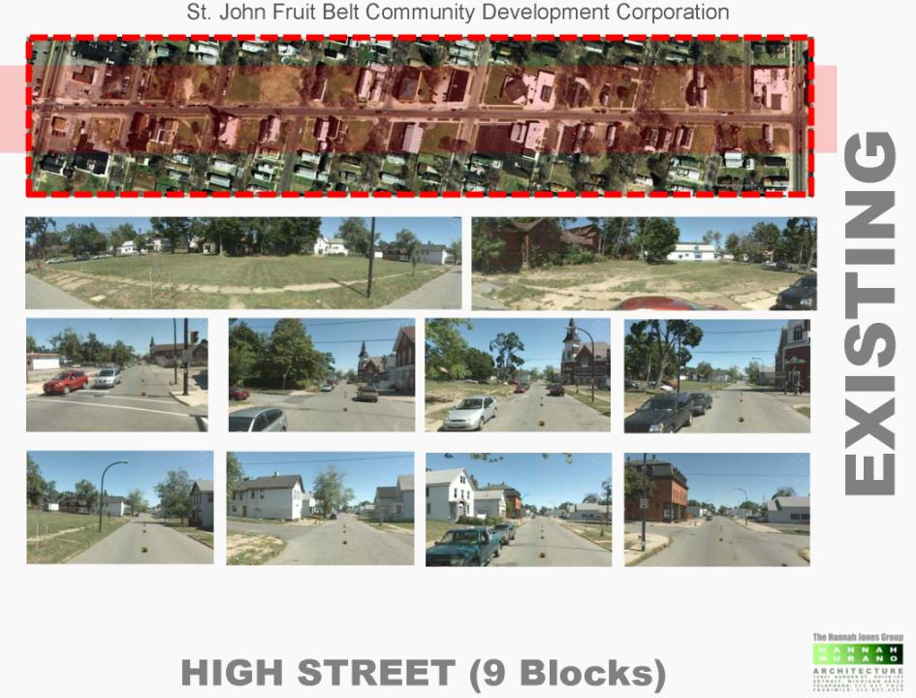

Slide 23
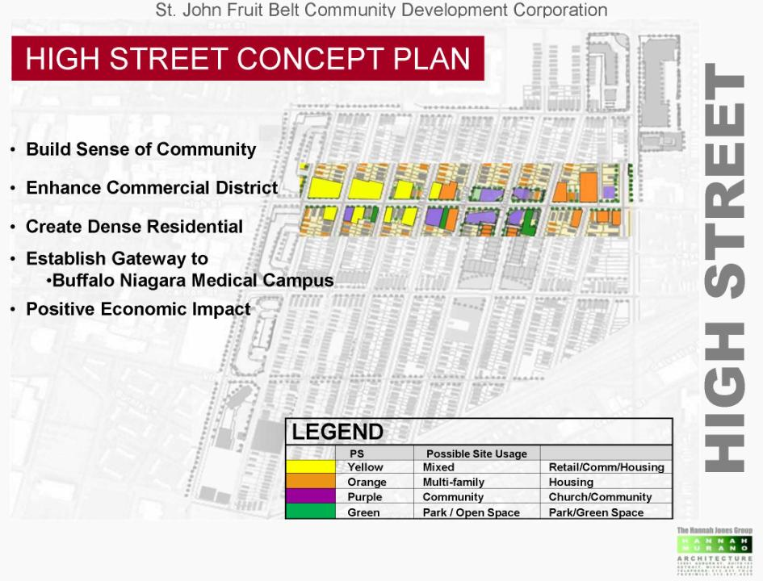

Slide 24
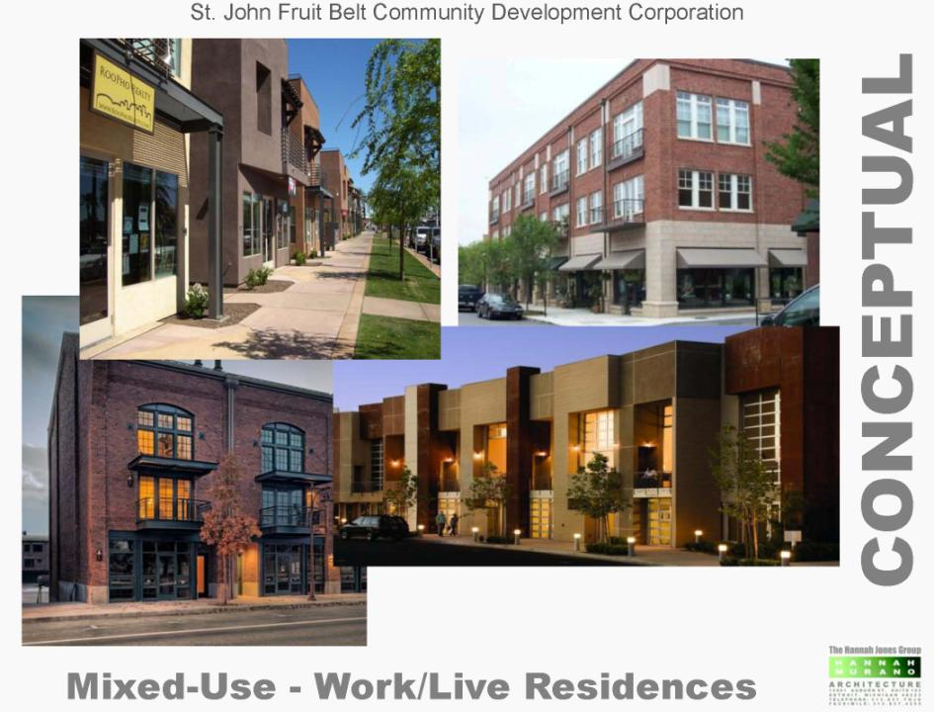

Slide 25
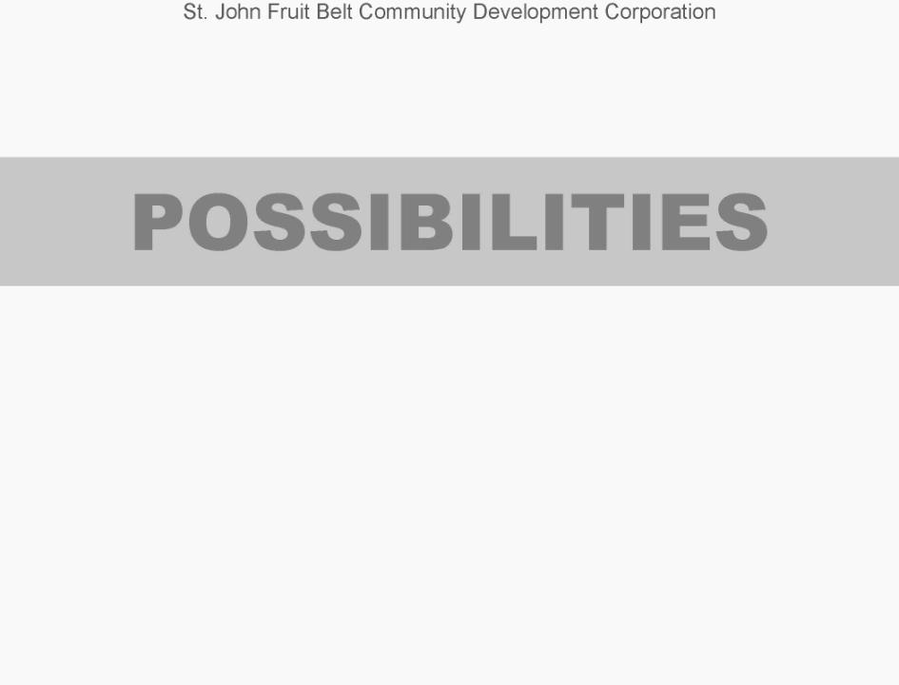

Slide 26
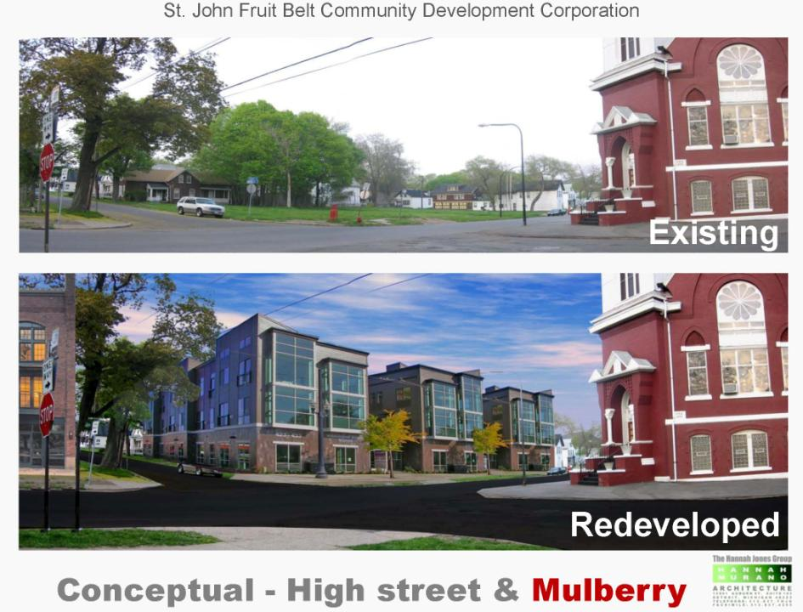

Slide 27
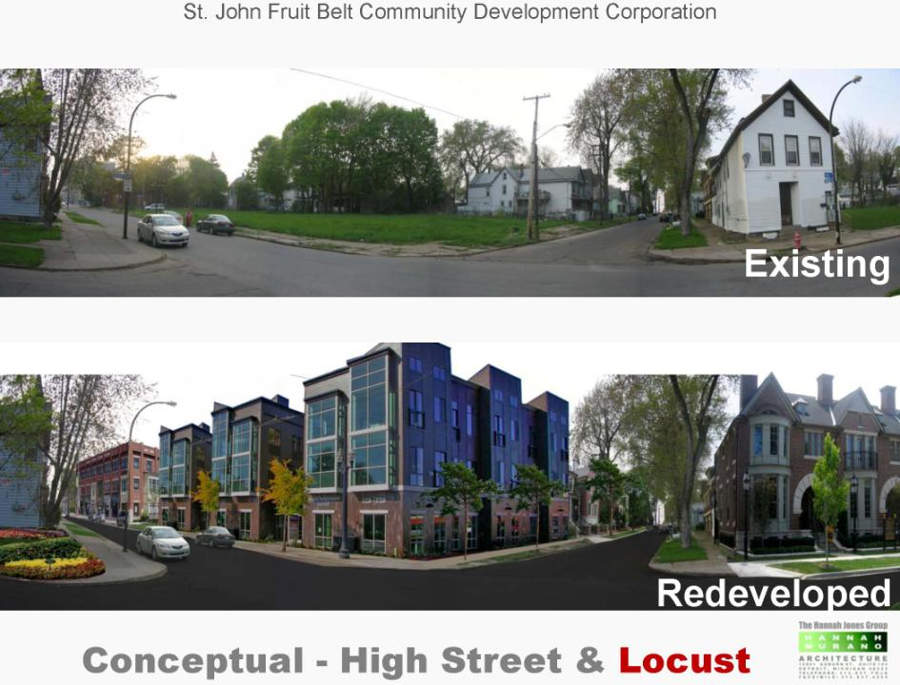

Slide 28
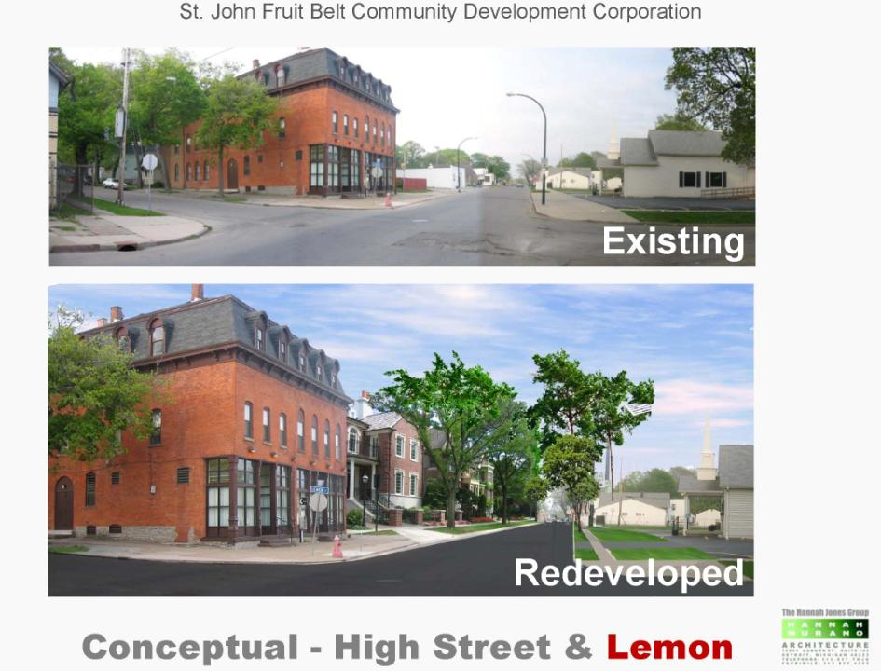

Slide 29
Fruit Belt Eastside
Leadership & Business Academy
Executive Trainees
  Creating Jobs and Opportunity
  Five Month Job Training Program
  Business Plan Development
  Project Development and Sustainability
  Creating Community Wealth
  Quality of Life Enhancement

Slide 30
Leadership & Business Academy Saturday Program
Raising Community Leaders & Entrepreneurs
3rd & 4th Grade Youth
Biblical Principles to create Wealth
Leadership Skills & Development
Educational Enrichment

Slide 31
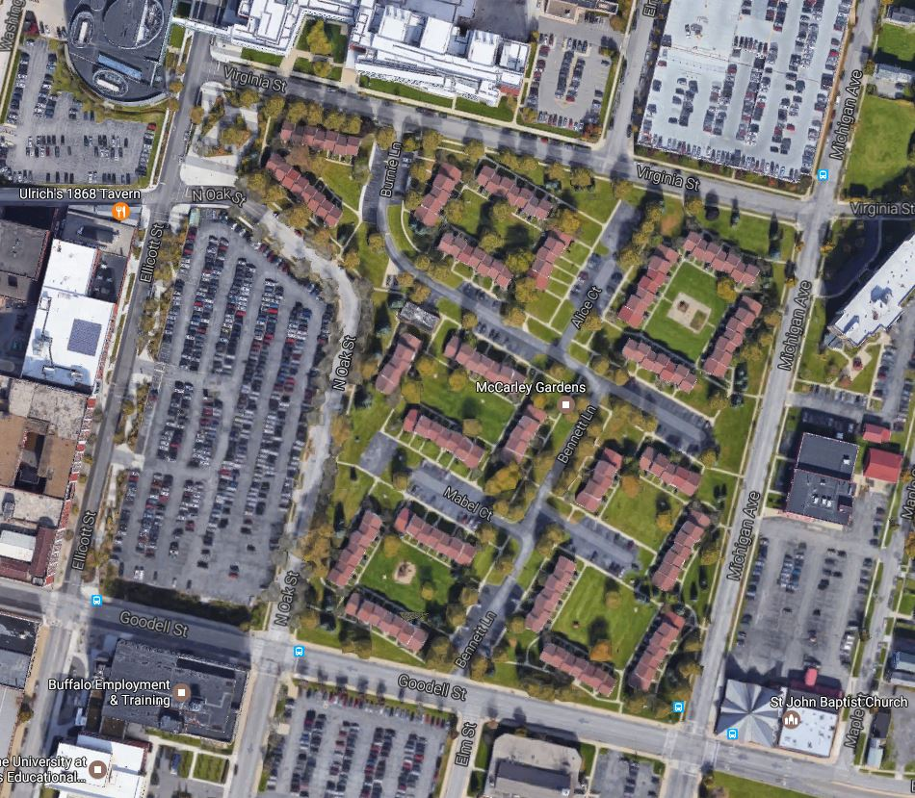
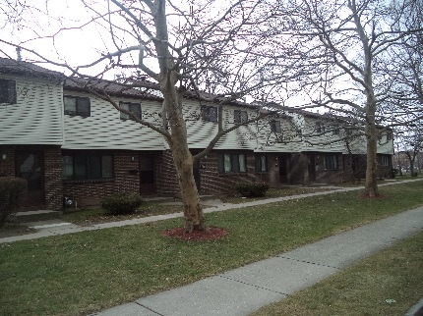
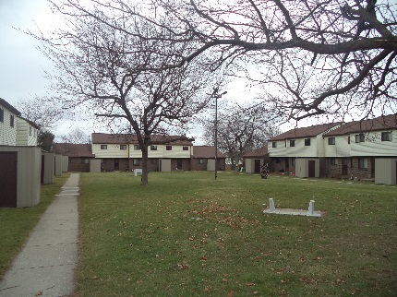
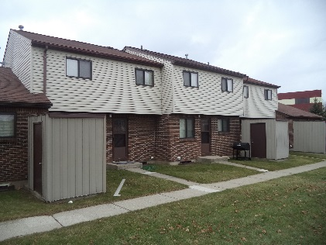
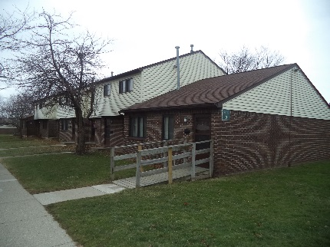
Existing Site

Slide 32
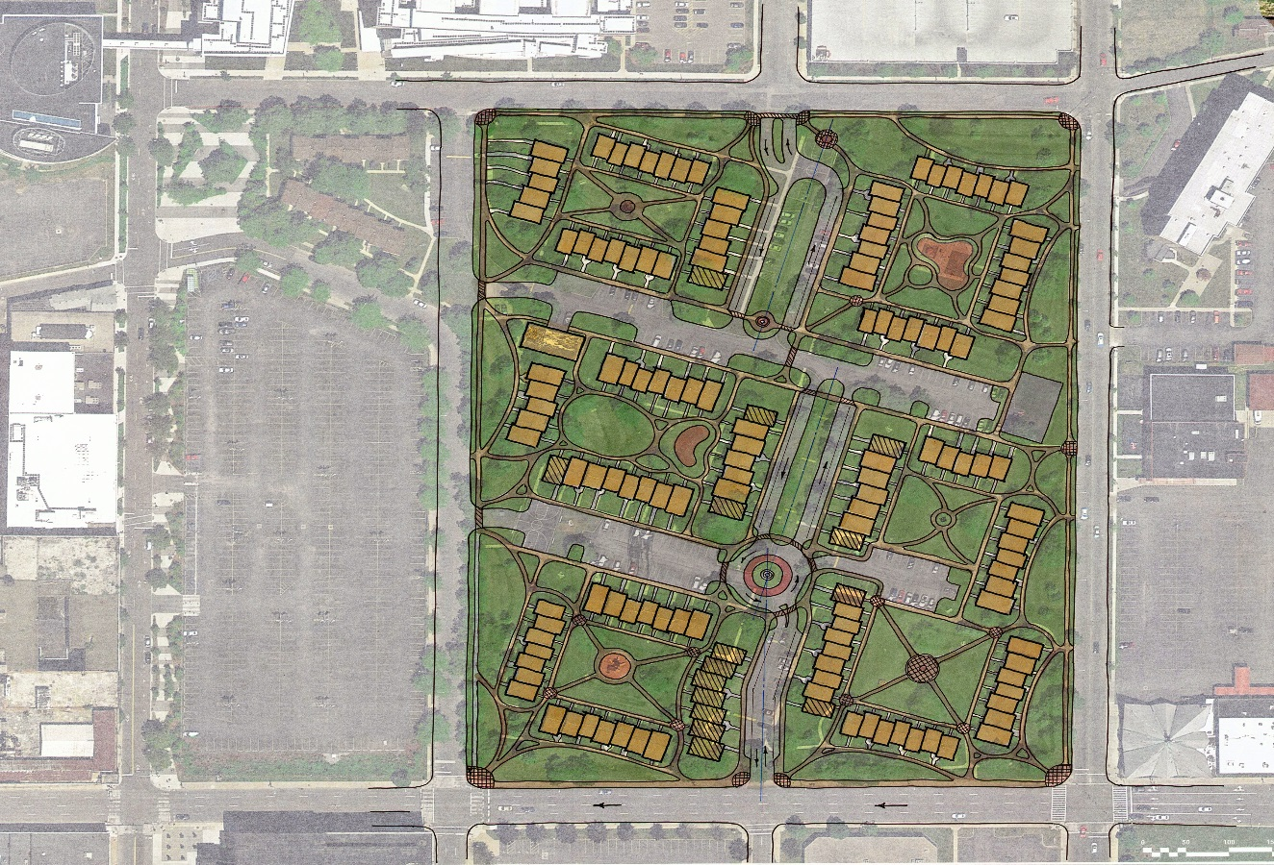
Site Plan – Concept Layout

Slide 33
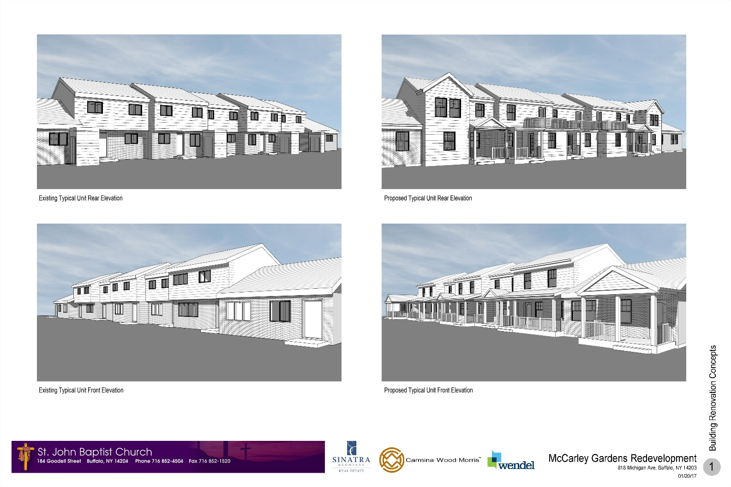
McCarley Building Concept

Slide 34
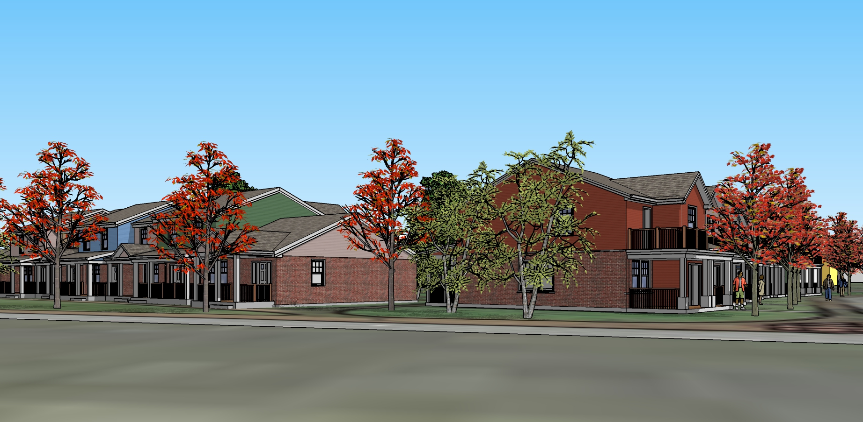
Concept Renderings

Slide 35
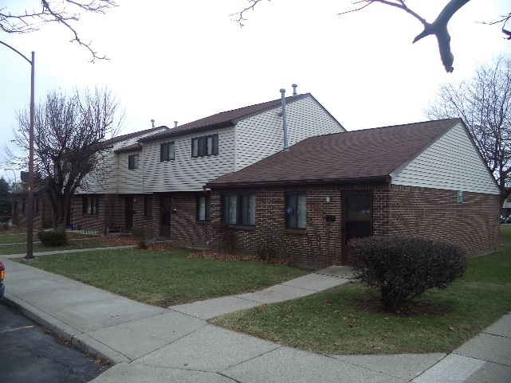
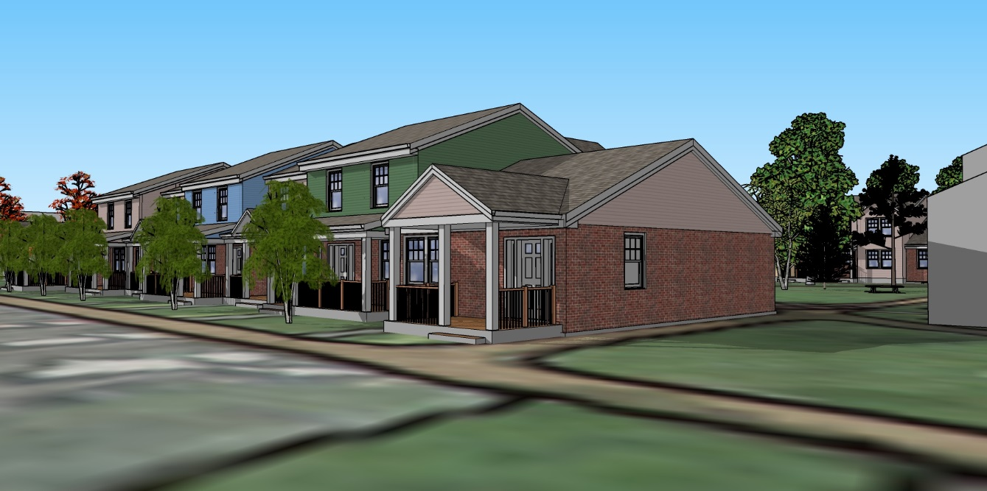
Concept Renderings
Existing View:
Unit Type A front entry
Concept View:
Unit Type A front entry

Slide 36
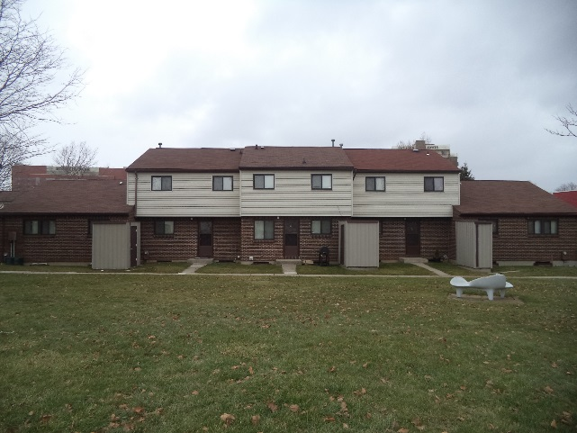
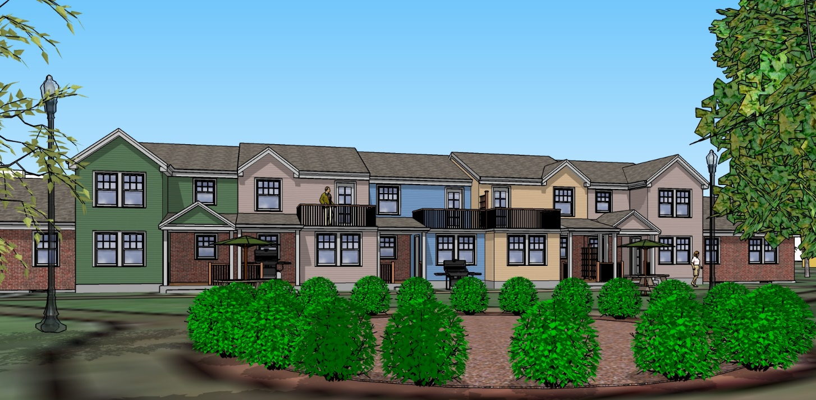
Concept Renderings
Existing View:
Unit Type A Courtyard
Concept View:
Unit Type A Courtyard View

Slide 37
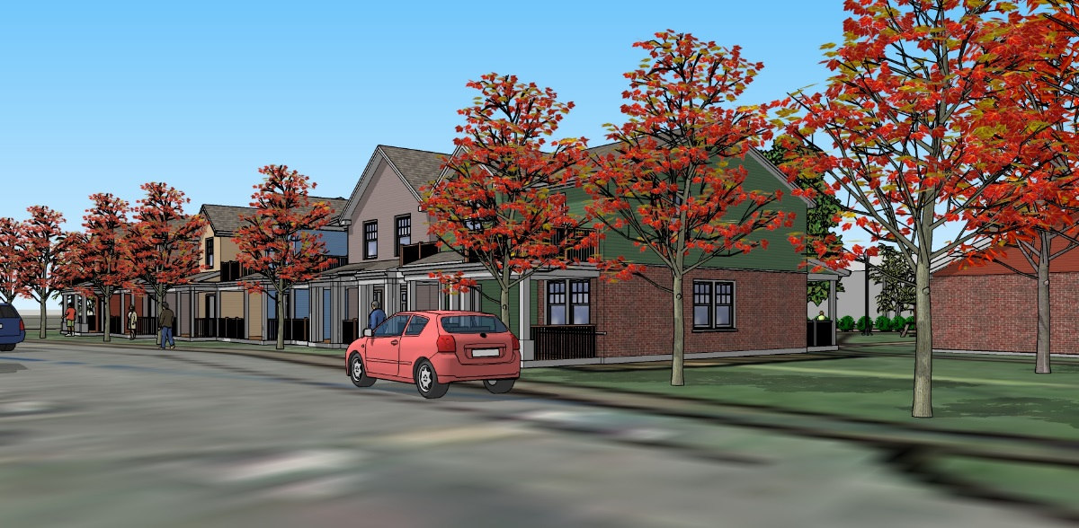
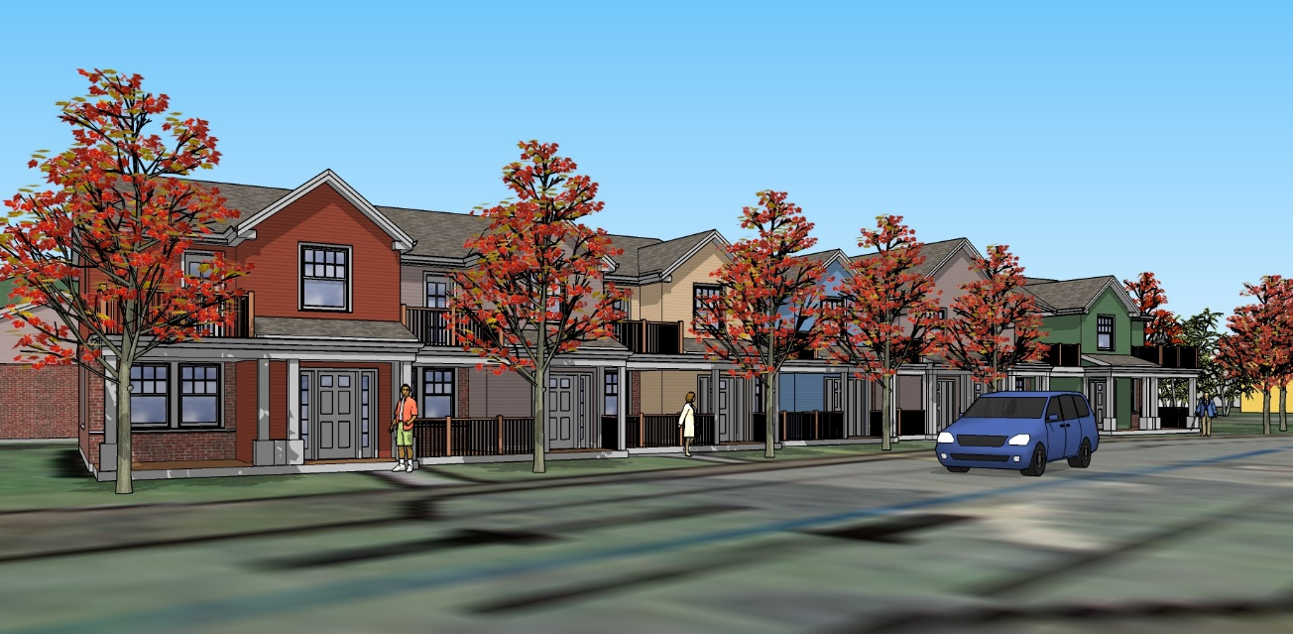
Concept Renderings
Concept View:
New Unit Front Entry views

Slide 38
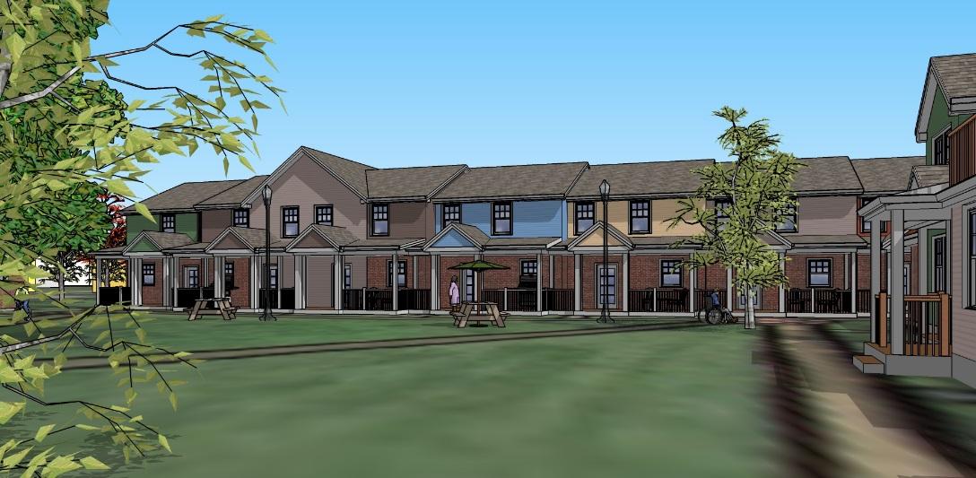
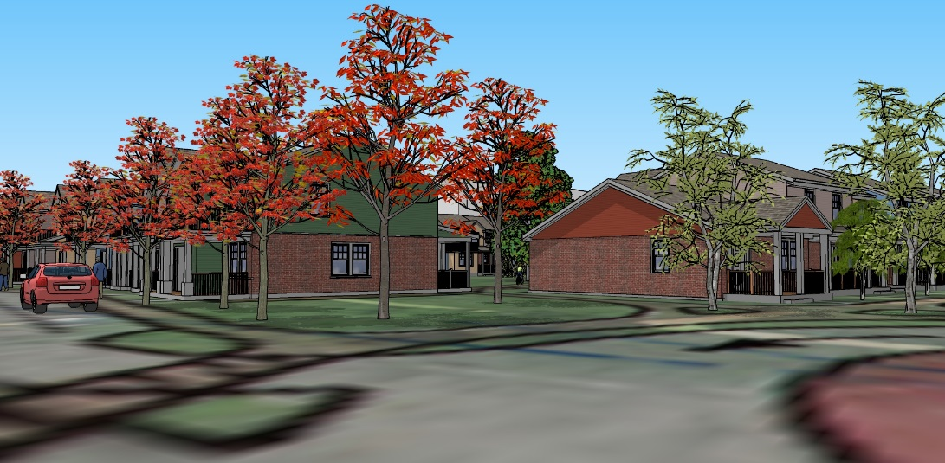
Concept Renderings
Concept View:
New & Existing Unit Street view
Concept View:
New Unit Courtyard view

Slide 39
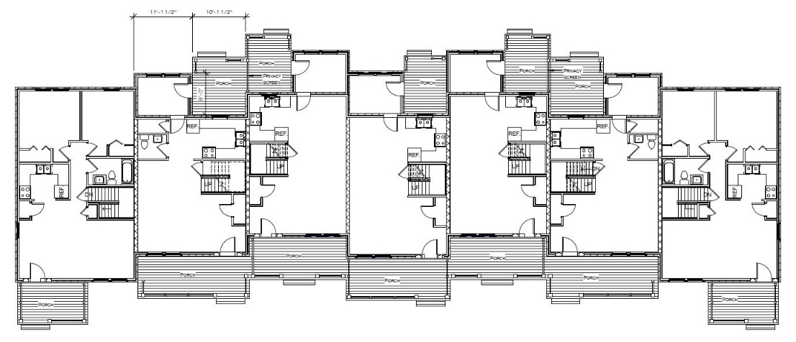
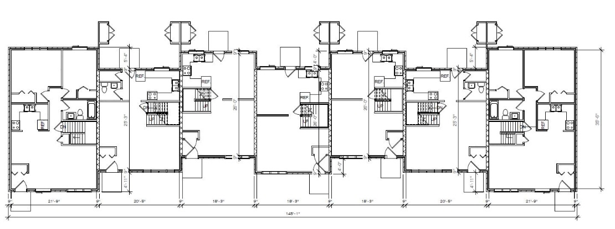
Building Concept Plans
Unit Type A Renovation Concept – 1st Floor Plan
Existing Unit Type A – 1st Floor Plan

Slide 40
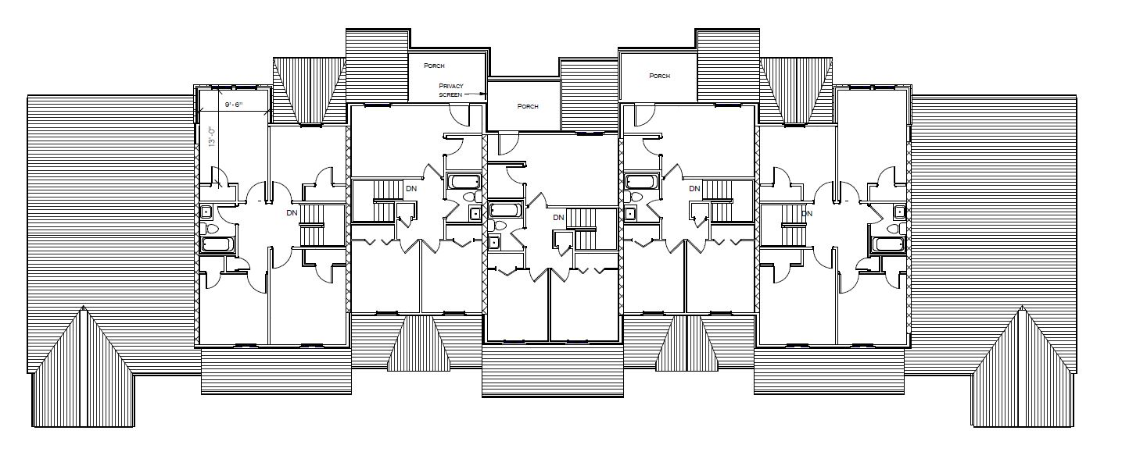
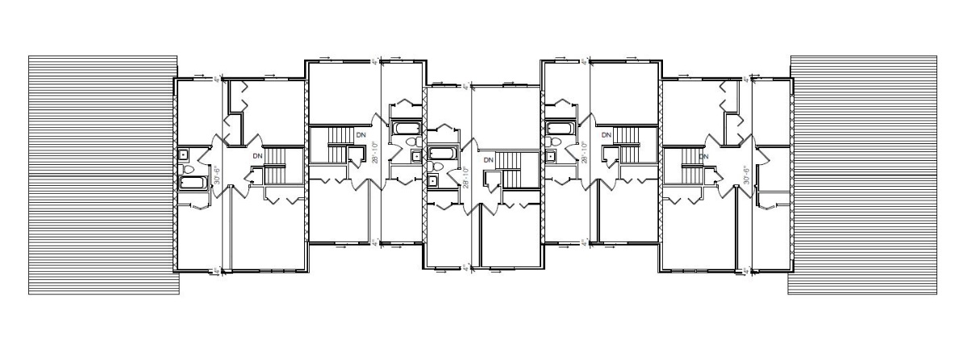
Building Concept Plans
Unit Type A Renovation Concept – 2nd Floor Plan
Existing Unit Type A – 2nd Floor Plan

Slide 41
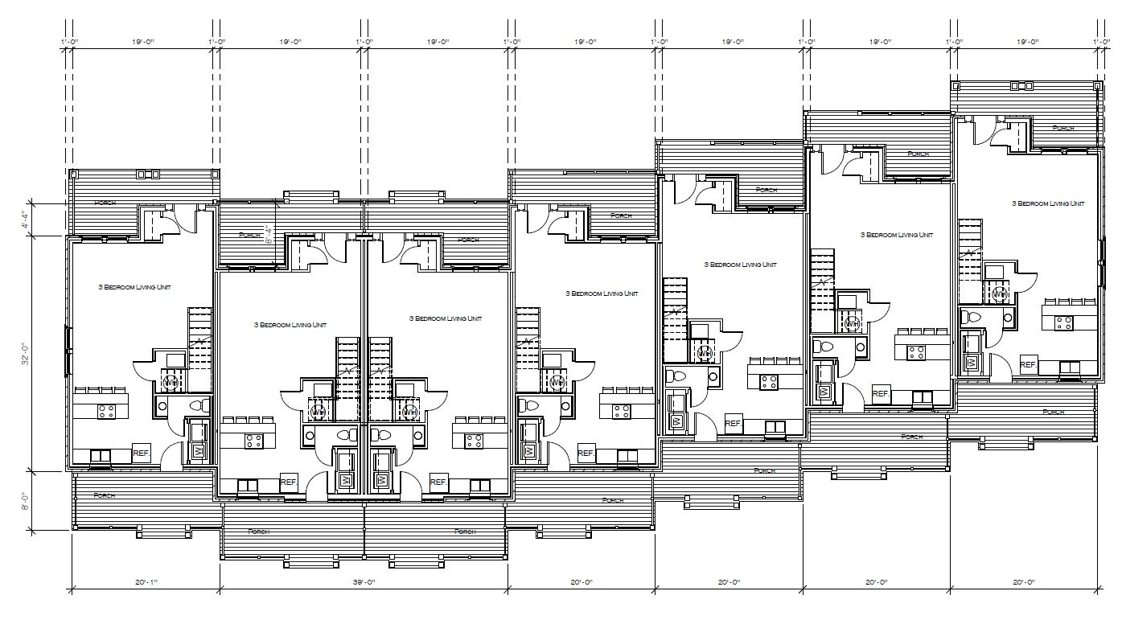
Building Concept Plans
Unit Type New Construction Concept 1st Floor Plan

Slide 42
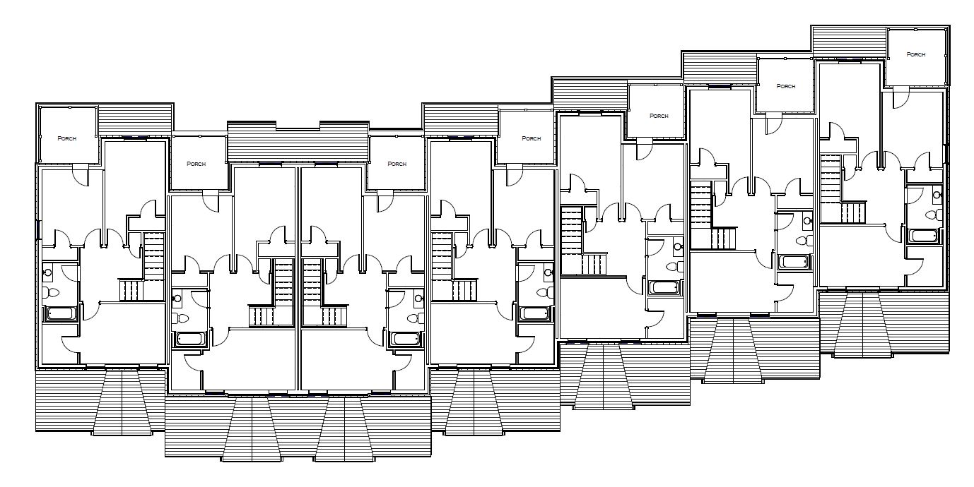
Building Concept Plans
Unit Type New Construction Concept 2nd Floor Plan

Slide 43
Project Narrative
Built in 1978, the 150-unit apartment complex has not received any significant facelift or interior upgrade since being completed. The McCarley Gardens revitalization will consist of a multi-phase reconstruction of infrastructure, landscape, new mechanical systems, flooring, roofing, windows, interiors, etc. The McCarley Gardens revitalization with be a complete renovation of the existing units/property which will rejuvenate the spaces and create a more walkable neighborhood with a more appealing aesthetic to allow for the project to successfully live on for the next 40 years, [projected construction cost forty million dollars].
Sinatra and Company will co-develop this project with the Oak Michigan Development Corporation, the long-time owner of McCarley Gardens apartments and work with community leaders and residents to create the best course of action. McCarley Gardens is representative of Sinatra and Company Real Estate’s commitment to Community Redevelopment Impact Investing to foster quality affordable housing in Buffalo.

Slide 46
The Tree of 40 Fruit is an ongoing series of hybridized fruit trees by contemporary artist Sam Van Aken. Each unique Tree of 40 Fruit grows over forty different types of stone fruit including peaches, plums, apricots, nectarines, cherries, and almonds. Sculpted through the process of grafting, the Tree of 40 Fruit blossom in variegated tones of pink, crimson and white in spring, and in summer bear a multitude of fruit. Primarily composed of native and antique varieties the Tree of 40 Fruit are a form of conversation, preserving heirloom stone fruit varieties that are not commercially produced or available. Tree of 40 Fruit Website

Slide 47


Slide 48
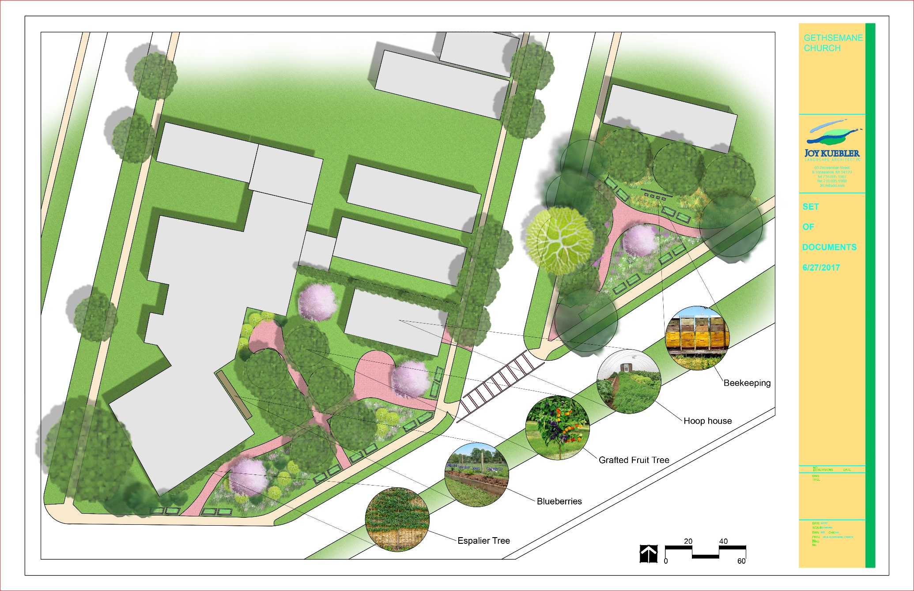
Gethsemane Church Design Concept Final Print

Slide 49

Gethsemane Church Design Concept Alternative Final Print

Slide 50
Fruit Belt Eastside
Community Development Project
Overseer Dr. Michael Chapman, Pastor
Corporate President & CEO
St. John Baptist Church Gethsemane Missionary Baptist Church
184 Goodell Street 55 Grape Street
Buffalo, New York 14204 Buffalo, New York 14204
Email: sjbc@stjohnbaptistbuffalo.org
Website: www.sjbcurbanmodel.org
Thank You,

